Slide 1
SVM-ALGO

Slide 2
Core Concepts
Hyperplane: An (n-1)-dimensional subspace that divides the space into two halves, used as the decision boundary for classification.
Support Vectors: Data points closest to the hyperplane that influence its position and margin; they are critical in defining the classifier.
Margin: The gap between the hyperplane and the closest support vectors, which SVM maximizes to improve generalization and classification performance.
​

Slide 3
Hard Margin vs. Soft Margin: Hard margin requires perfect separation with no misclassification, which is often not possible. Soft margin allows some misclassifications to balance margin size and errors, handled through slack variables and regularization.
Kernel Trick: Enables SVM to perform non-linear classification by implicitly mapping input data into higher-dimensional spaces using kernel functions (e.g., linear, polynomial, radial basis function (RBF)) without explicitly computing the transformation.
Regularization Parameter (C): Controls trade-off between maximizing margin and minimizing classification error; a higher value penalizes misclassification more strictly.​
Hinge Loss: The loss function used in SVM that penalizes points violating the margin or misclassified, combined with regularization in the optimization problem.

Slide 4
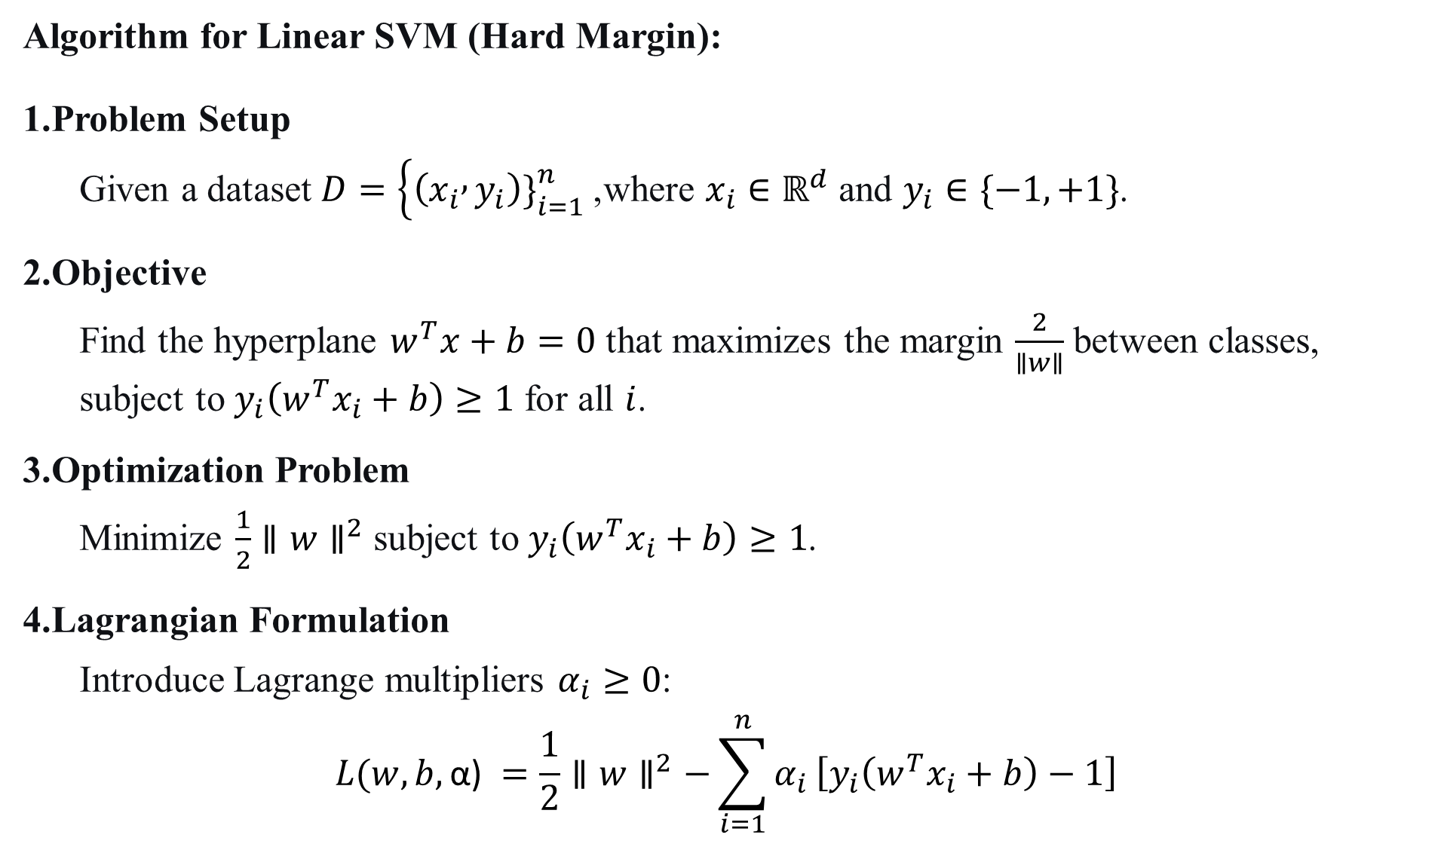
Algorithm for Linear SVM (Hard Margin):
Problem Setup
Given a dataset $D=\left\{\left(x_{i} , y_{i}\right){\left.\}\right.}_{i=1}^{n}\right.$, where $x_{i}∈ℝ^{d}$ and $y_{i}∈\{−1, +1\}$.
Objective
Find the hyperplane $w^{T}x+b=0$ that maximizes the margin $\frac{2}{∥w∥}$ between classes, subject to $y_{i}\left(w^{T}x_{i}+b\right)≥1$ for all $i$.
Optimization Problem
Minimize $\frac{1}{2}∥w∥^{2}$ subject to $y_{i}\left(w^{T}x_{i}+b\right)≥1$.
Lagrangian Formulation
Introduce Lagrange multipliers $α_{i}≥0$:
$$L(w,b,\text{α}\text{)} =\frac{1}{2}∥w∥^{2}−\sum_{i=1}^{n}{α_{i}}\left[y_{i}\left(w^{T}x_{i}+b\right)−1\right]$$

Slide 5
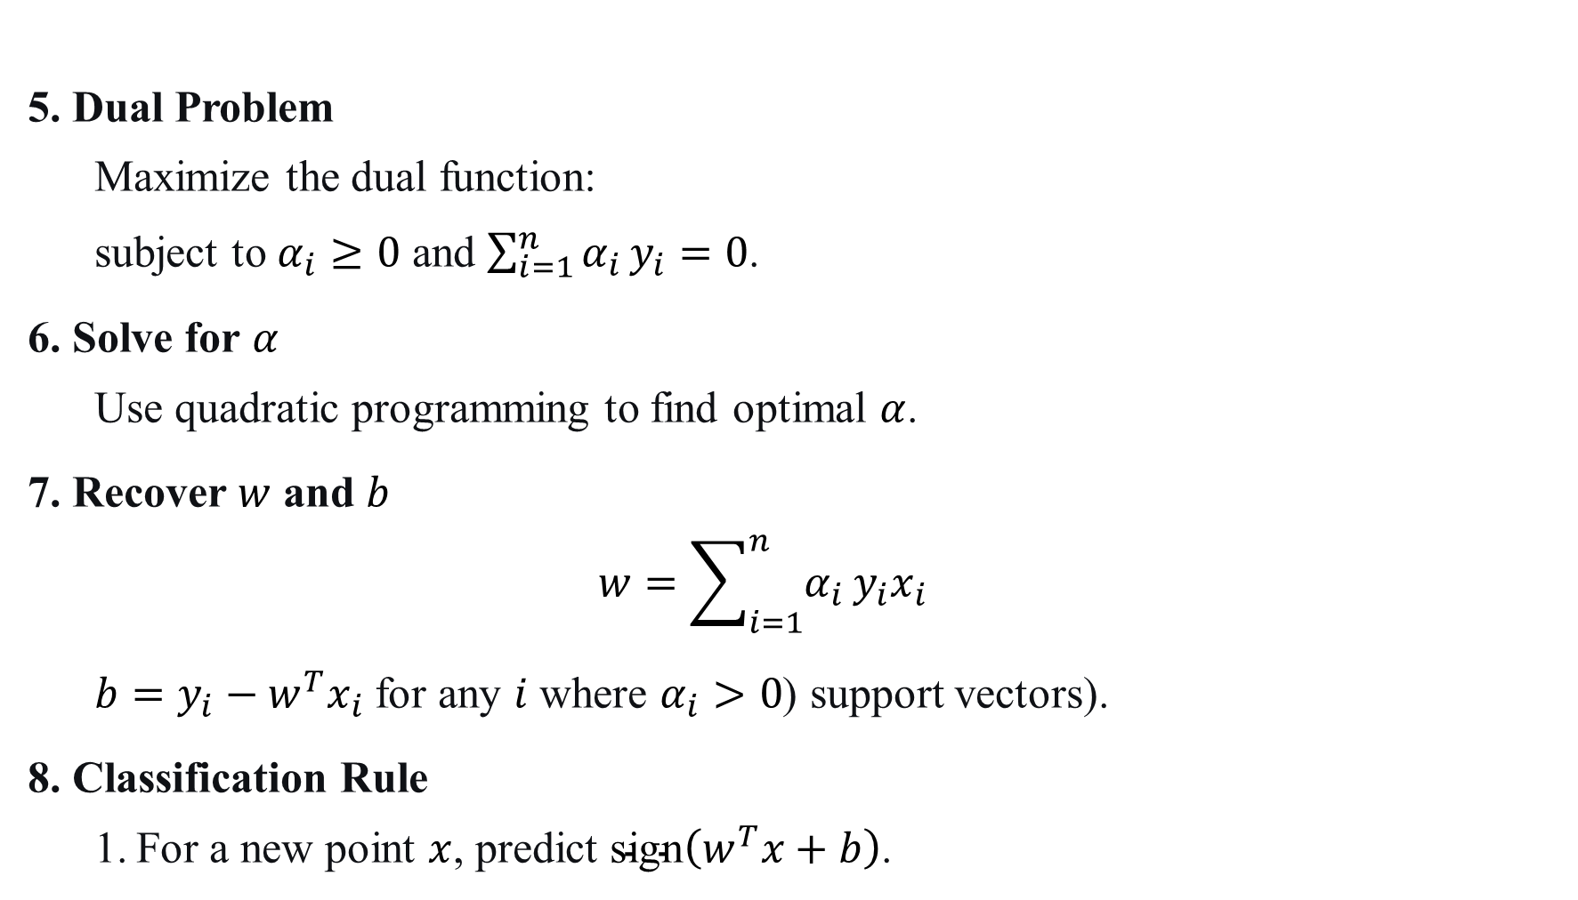
5. Dual Problem
Maximize the dual function:
subject to $α_{i}≥0$ and $\sum_{i=1}^{n}{α_{i}}y_{i}=0$.
6. Solve for $α$
Use quadratic programming to find optimal $α$.
7. Recover $w$ and $b$
$$w=\sum_{i=1}^{n}{α_{i}}y_{i}x_{i}$$
$b=y_{i}−w^{T}x_{i}$ for any $i$ where $α_{i}>0$ (support vectors).
8. Classification Rule
For a new point $x$, predict $\text{sign}\left(w^{T}x+b\right)$.

Slide 6

Example: Linear SVM with 2D Data
Dataset:
Class +1: (1,2), (2,2)
Class -1: (0,0), (1,0)
Step 1: Write Constraints For each point:
(1,1)$,y=+1$ : $w_{1}+w_{2}+b≥1$
(2,2)$,y=+1$: $2w_{1}+2w_{2}+b≥1$
(0,0)$,y=−1$: $−b≥1⇒b≤−1$
(1,0)$,y=−1$: $−w_{1}−b≥1⇒w_{1}+b≤−1$

Slide 7
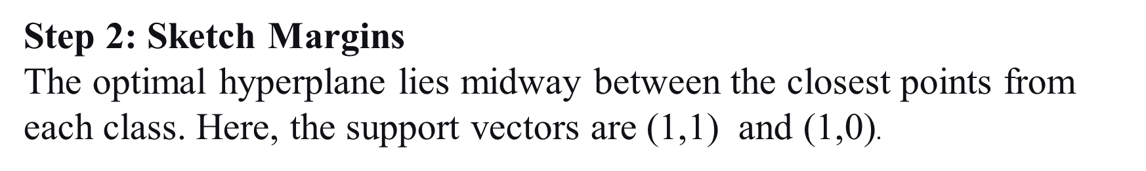
Step 2: Sketch Margins The optimal hyperplane lies midway between the closest points from each class. Here, the support vectors are (1,1) and (1,0).

Slide 8
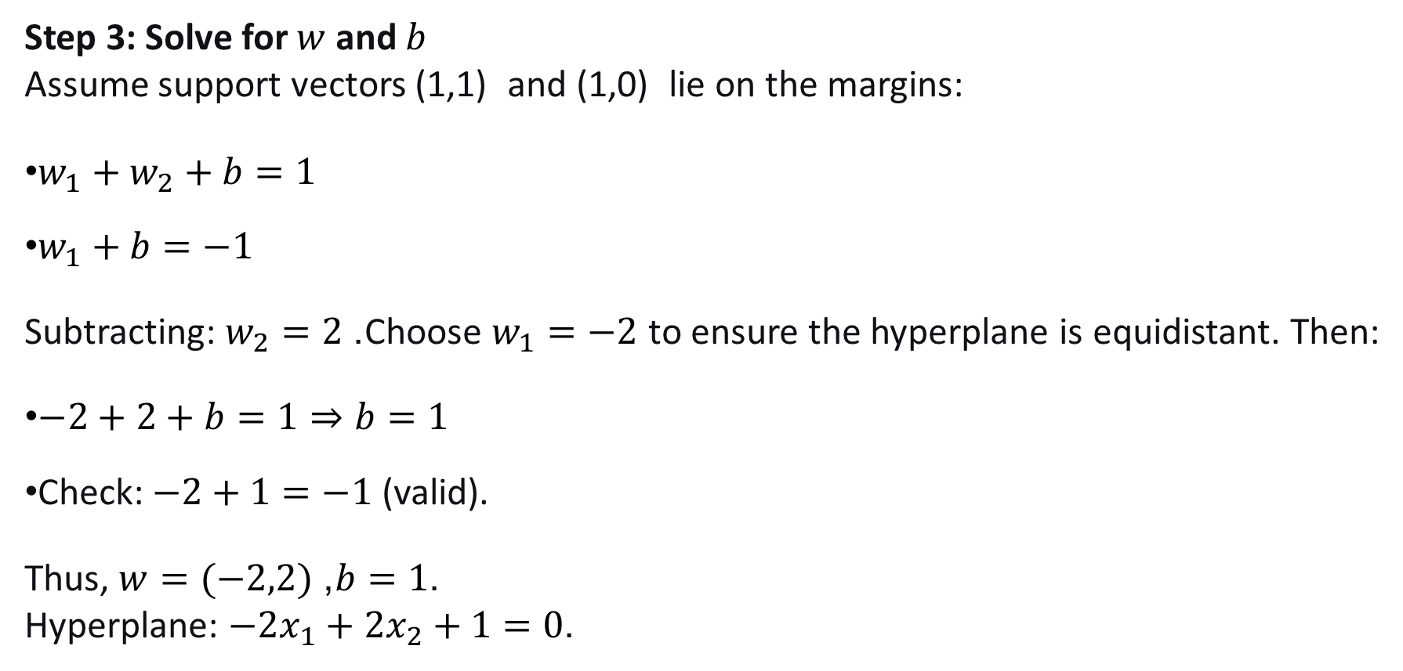
Step 3: Solve for $w$ and $b$ Assume support vectors (1,1) and (1,0) lie on the margins:
$w_{1}+w_{2}+b=1$
$w_{1}+b=−1$
Subtracting: $w_{2}=2$. Choose $w_{1}=−2$ to ensure the hyperplane is equidistant. Then:
$−2+2+b=1⇒b=1$
Check: $−2+1=−1$ (valid).
Thus, $w=(−2,2)$, $b=1$. Hyperplane: $−2x_{1}+2x_{2}+1=0$.

Slide 9
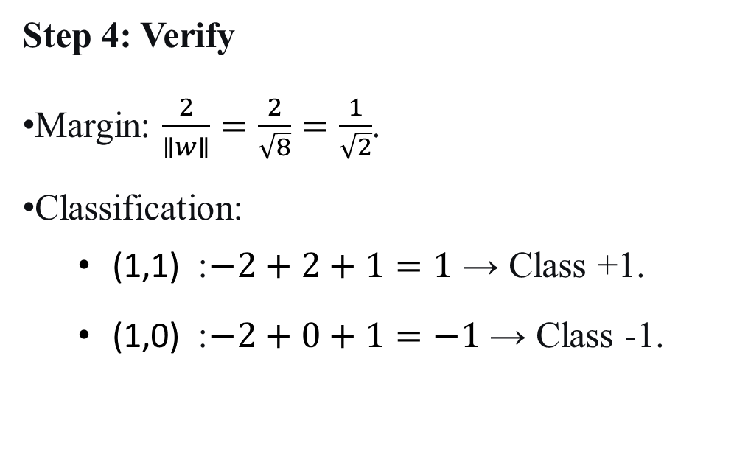
Step 4: Verify
Margin: $\frac{2}{∥w∥}=\frac{2}{\sqrt{8}}=\frac{1}{\sqrt{2}}$.
Classification:
(1,1) : $−2+2+1=1$ → Class +1.
(1,0) : $−2+0+1=−1$ → Class -1.
**
For non-linearly separable data, use soft-margin SVM with slack variables.
For non-linear boundaries, use kernel tricks (e.g., RBF, polynomial).
.

Slide 10
The Lagrangian formulation is not just a mathematical trick - it's a fundamental approach that:
Transforms constrained problems into unconstrained ones
Reveals important structural insights (like support vectors)
Enables powerful techniques (like kernel methods)
Provides both practical algorithms and theoretical understanding
It's the mathematical backbone that makes SVM both theoretically elegant and practically powerful!

Slide 11
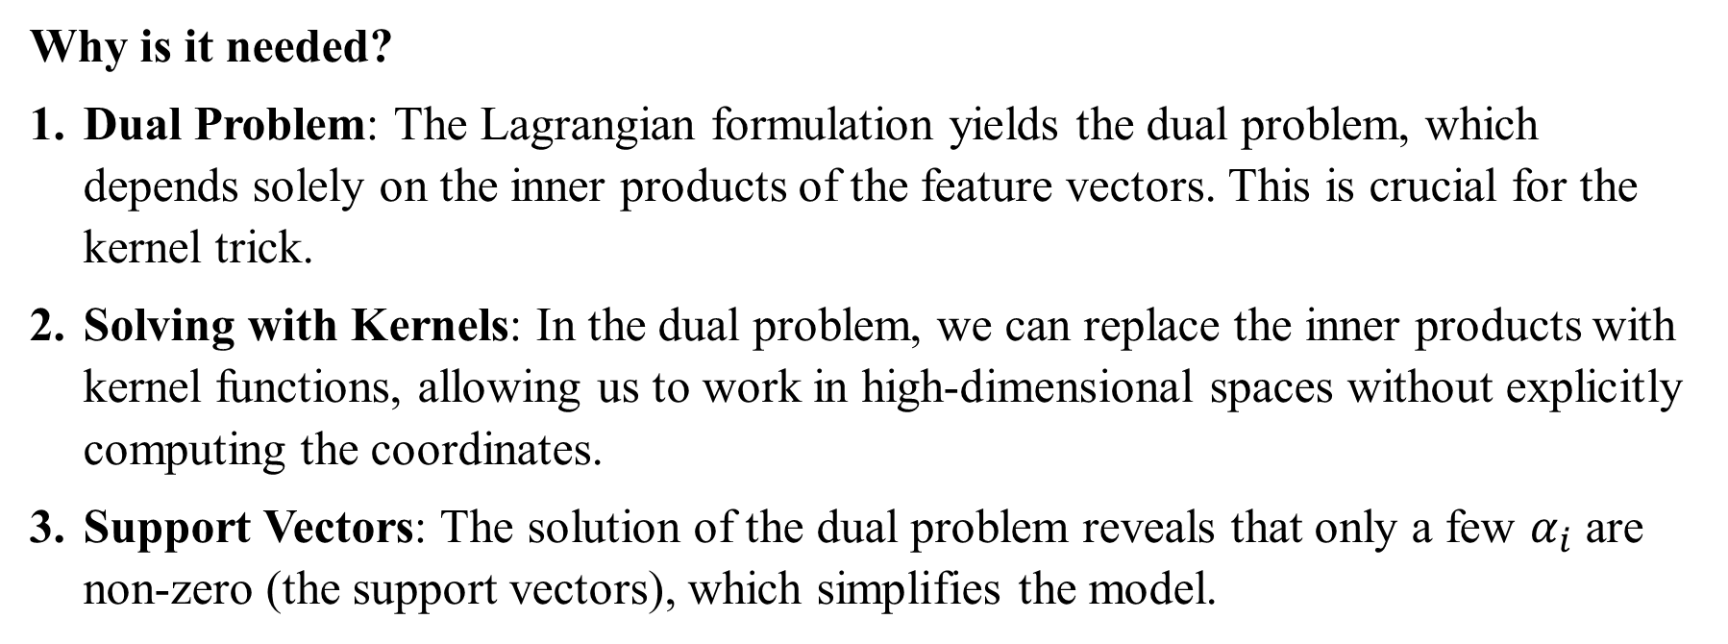
Why is it needed?
Dual Problem: The Lagrangian formulation yields the dual problem, which depends solely on the inner products of the feature vectors. This is crucial for the kernel trick.
Solving with Kernels: In the dual problem, we can replace the inner products with kernel functions, allowing us to work in high-dimensional spaces without explicitly computing the coordinates.
Support Vectors: The solution of the dual problem reveals that only a few $α_{i}$ are non-zero (the support vectors), which simplifies the model.

Slide 12
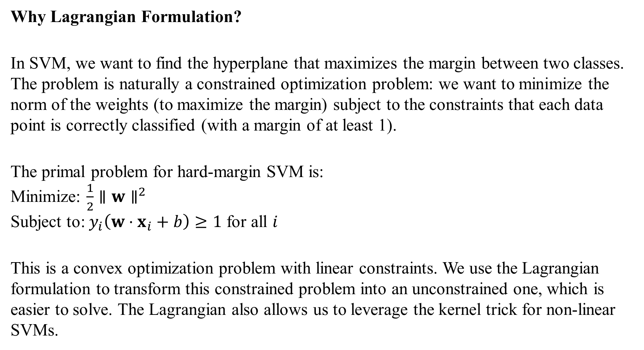
Why Lagrangian Formulation?
In SVM, we want to find the hyperplane that maximizes the margin between two classes. The problem is naturally a constrained optimization problem: we want to minimize the norm of the weights (to maximize the margin) subject to the constraints that each data point is correctly classified (with a margin of at least 1).
The primal problem for hard-margin SVM is: Minimize: $\frac{1}{2}∥w∥^{2}$ Subject to: $y_{i}\left(w⋅x_{i}+b\right)≥1$ for all $i$
This is a convex optimization problem with linear constraints. We use the Lagrangian formulation to transform this constrained problem into an unconstrained one, which is easier to solve. The Lagrangian also allows us to leverage the kernel trick for non-linear SVMs.

